Slide 1
Online Course Showcase: Faculty Accomplishments from Design a Quality Online Course 2013
Marcena Gabrielson, May Jadallah, William McBride, Rick Valentin, Eric Wesselmann
Center of Teaching, Learning, and Technology
CTLT Annual Symposium, January 2014
Illinois State University, Normal, IL

Slide 2
Quality Matters
May Jadallah
School of Teaching and Learning

Slide 3
Quality Matters
The eight general standards include: (PDF)
Course Overview and Introduction
Learning Objectives (Competencies) (PDF)
Assessment and Measurement
Instructional Materials
Learner Interaction and Engagement
Course Technology
Learner Support
Accessibility
May

Slide 4
Notes:
The Quality Matters Rubric is a set of 8 general standards and 41 specific standards used to evaluate the design of online and blended courses.
Unique to the Quality Matters Rubric is the concept of alignment. This occurs when critical course components - Learning Objectives (2), Assessment and Measurement (3), Instructional Materials (4), Learner Interaction and Engagement (5), and Course Technology (6) - work together to ensure students achieve desired learning outcomes.

Slide 5
Design Elements
Eric Wesselmann
Department of Psychology
Eric

Slide 6
Thinking of Teaching Like Scientific Research
Ask research question
Identify variables* / specify hypotheses
Define population
Select research method⌘
Collect data from sample⌘
Analyze data
Interpret findings
Distribute findings
*Conceptual Definitions
⌘Operational Definitions
6
Notes:
EDW
My training was at an R-1 university, I got little systematic training in terms of good teaching; lots of trial by fire.
The workshop this summer not only focused on effective online teaching, but gave us training on effective teaching more generally. [focus: measurable outcomes]
My epiphany this summer was to think of teaching like research. “Effective teaching methods” – [interventions / manipulations]; “measurable outcomes” [outcome variables / data]
Basic Learning theories in psych: how to affect a change in an organism’s thoughts, feelings, and behaviors. That’s what we do as teachers.
BASIC review of scientific method.
Focus on highlighted steps – most relevant to SoTL
Conceptual and operational definition.
Conceptual definitions describe variables in terms of theoretical concepts.
Operational definitions describe variables in terms of specific operations/procedures and measurements that result. [observable and quantitative]

Slide 7
Conceptual Definition: Ostracism
When someone excludes & ignores another person.
7
(Williams 2009, Advances in Experimental Social Psychology)
Notes:
EDW
What is ostracism? Goes by many names colloquially…
In our field (my lab, and others), we define it as “excluding AND ignoring”.
So how to we contrive a situation to manipulate this experimentally (Intervention), and measure its effects to test the effectiveness of this intervention (measurable outcomes / operational definitions)?

Slide 8
Operational Definitions
Ostracism
Inclusion
Participant
Participant
8
(Wesselmann, Ren, Swim, & Williams, 2013, IJDS)
Notes:
EDW
Explain cyberball - Click to transition to ostracism.
Told they are playing online with 2 other people over our network. The goal of the task is mental visualization, not ball tossing. They should simply use this as a vehicle to practice visualizing their surroundings, what the other players might be like, etc.

Slide 9
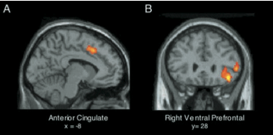
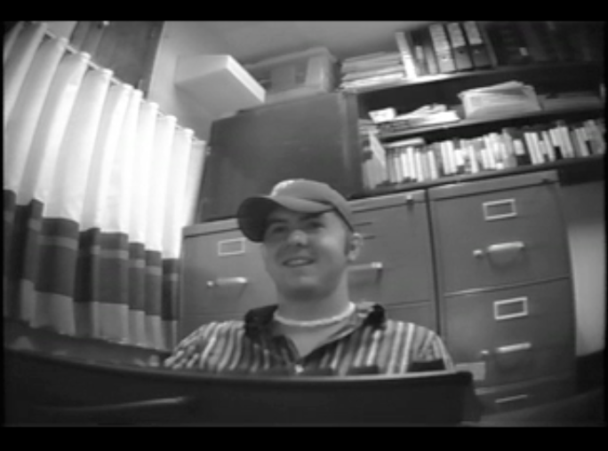
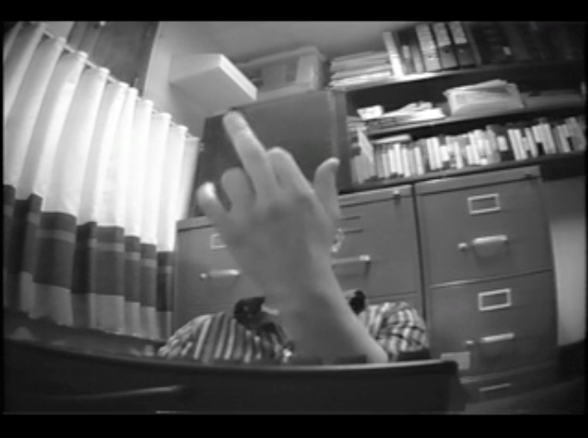
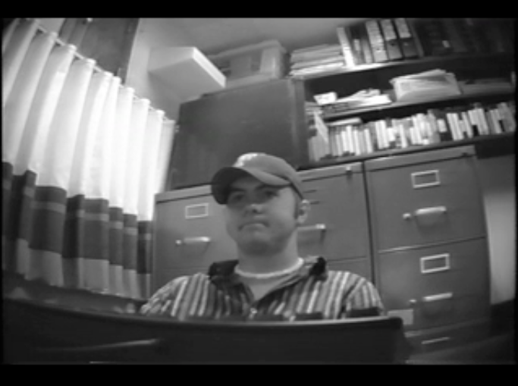
Operational Definitions
9
(Eisenberger et al., 2003, Science; Williams 2009, Advances in Experimental Social Psychology)
Notes:
EDW
Some examples of how this minimal interaction seems to get at real world experiences
1 min game

Slide 10
Operational Definitions
How ignored / excluded did you feel (1-not at all; 5-very much so)
t(110) = 12.24, p < .01, d = 2.30
10
(Wesselmann, Ren, Swim, & Williams, 2013, IJDS)
Notes:
EDW
Outcome measure – did our manipulation [intervention] do what it was theoretically supposed to?
in this case, YES: example – d score of .8 is typically considered a large effect size (many effect sizes in medical research are between small and medium).

Slide 11
Psychology
Social Psychology, 200-level survey course
Transformational Goal [Conceptual definition]
Ex: I want my students to perceive psychological science as “relatable” to their everyday lives.
How to Quantify This? [Operational definition]
“relatable” to their everyday lives
Application [Bloom’s Taxonomy]
11
Notes:
EDW
Situational Factors
Social Psychology, 200-level survey course
Traditional class: N > 200
Major and non-majors
Online class – all online (asynchronous)
Projected N = 30
Putting the “scientific research approach” into practice

Slide 12
Psychology
Operational definition: relatable / application
Activities [practice: “intervention”]
Brief reflections on class activities [five-min. paper]
Assessment [evaluation: “dependent/outcome measure”]
Journal entries
Identify and clearly define course concept
Describe life event that illustrates concept; explain why.
Describe life event that DOES NOT fit concept; explain why.
12
Notes:
EDW
Brief Reflections on Class Activities (10 points):
The goal of this reflection assignment is to have you write brief reflections on the five class activities. I will give you a reflection question for each activity and you will write a one-paragraph (approximately 5 sentences) reflection on this question. Each reflection will be worth 2 points. The due dates are listed toward the end of the syllabus.
Journal Entries (80 points):
The goal of this assignment is to encourage you to reflect upon how different class topics influence your own lives. You will be asked to pick a concept from one of the modules in that section and answer several questions. Most entries will be about 2 double-spaced pages in length, although some may be longer as needed to adequately describe the incident and link it to course materials. There will be four journal entries in total, each worth 20 points.
Questions to address in the entry:
Clearly define the course concept and which module it is from
Describe an event in your life that you believe is a strong illustration of the concept. Be as detailed as possible. Describe the setting, any people involved, and any other details you believe are relevant.
Clearly detail how the course concept is related to what happened in this event. How does viewing your life event in the context of the course topic change your perspective about it?
Describe an event in your life that does not fit the course concept. Be as detailed as possible. Describe the setting, any people involved, and any other details you believe are relevant.
Clearly detail how your life event contradicts the course concept. Why do you think your life event doesn’t fit what we know about this concept from scientific research? [ME: illustrate complexities of scientific research, interactions, boundary conditions]

Slide 13
Arts Technology
Rick Valentine
School of Arts

Slide 14
ATK 301
Web Design and Development
( test site )

Slide 15
Technical
+
Creative

Slide 16
Standards Compliant
HTML/CSS

Slide 17
Professional Design

Slide 18
Lecture
Critique
Lab

Slide 19
~15 students with a wide range of skills and backgrounds

Slide 20
Seven Semesters
First Two Years: Custom Site
Currently: ReggieNet

Slide 21
Greatest Fear
Losing contact with students

Slide 22
Learning Objectives
( a few )

Slide 23
Objective 1
Students will be able to build static, standards-compliant websites utilizing HTML5 and CSS.

Slide 24
Learning Activities and Assessments for Objective 1
Lecture, lecture, lecture
Weekly assignments

Slide 25
Converting Objective 1 from Classroom to Online
Video Lectures
Assignments (same)

Slide 26
Video Lectures

Slide 27
Broken up into pieces

Slide 28
More dynamic?

Slide 29
Occasional webcam?

Slide 30
Even shorter?

Slide 31
Modules or
Resources & Materials?

Slide 32
Objective 2
Students will be able to critique/analyze the successful and unsuccessful elements of their own site design, their peers’ site designs and designs available across the web.

Slide 33
Learning Activities and Assessments for Objective 2
Website presentations In-class critiques

Slide 34
Converting Objective 2 from Classroom to Online
Discussion forum

Slide 35
Participation?
Points for posts?

Slide 36
Not exclusive to online
The “talkers” ( 10% )
The “texters” ( 90% )

Slide 37
Objective 3
Students will begin to develop personal standards for professional work.

Slide 38
Learning Activities and Assessments for Objective 3
Classroom Discussion

Slide 39
Converting Objective 3 from Classroom to Online
Design Journal / Blog
( not just for online! )

Slide 40
Online to Classroom

Slide 41
Lecture Heavy

Slide 42
Blended Course
Video lectures open up class time
for direct instruction / lab

Slide 43
Film & Drama
Department of English

Slide 44
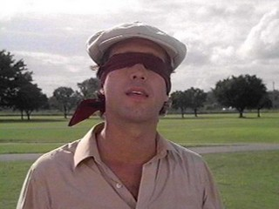
ENG 124
Film Style & Literature
ReggieNet
( Course Website)

Slide 45
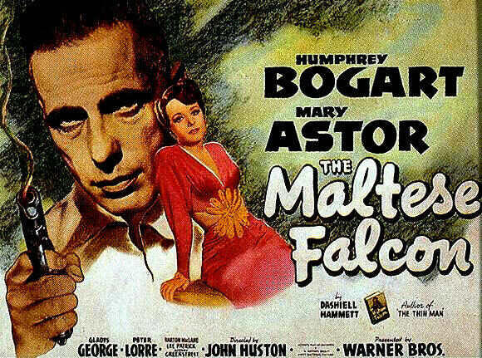
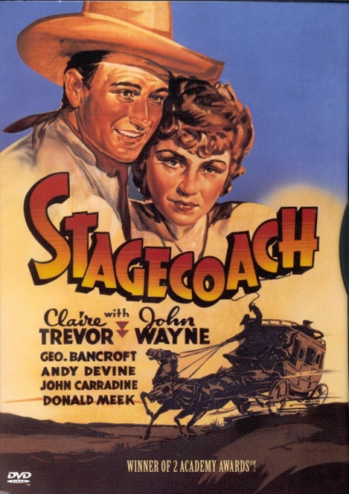
30 students or
100 w/ TA
Middle Core
Gen Ed

Slide 46
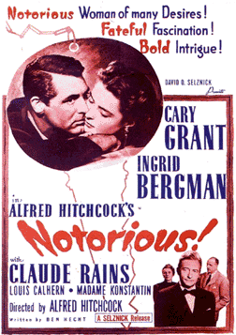
Advantages
Asynchronicity
Films streamed to student devices
“Lectures” contained in Textbook

Slide 47
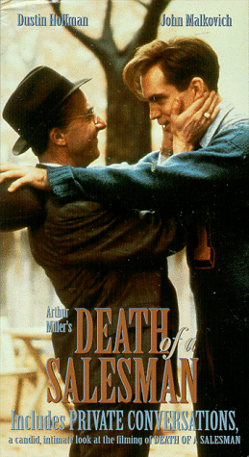
Stylized Moments: Turning Film Style Into Meaning
Smashwords

Slide 48
Think of this course as an intensive English Department literature course in which
you write essays in a "foreign" language--the language of film. The theory of Film
Style & Literature argues that style can be described, analyzed, and turned into
meaning via metaphor. Your goal is to acquire adequate film vocabulary and skill to convert your observations of camera placement and movement, lighting, spatial
relationships, soundtrack, etc. into an analysis of the meaning of a "stylized moment” and, from that, of the film as a whole. Do not be misled by the fact that this is a 100 level General Education course--it is nonetheless challenging.
It is essential to distinguish between style and significance: all stylized moments carry meaning, not all significant moments are stylized--see Guide to Writing Papers and eTextbook.

Slide 49
Learning Activities and Assessments
Weekly 250 word posts on films & textbook
2 1000 word essays
requiring accurate descriptions, convincing interpretations

Slide 50
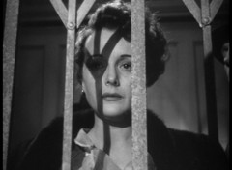
Learning Objectives
Students learn the language of film and interpretive strategies which they can apply to all texts and life.

Slide 51
Research For Professional Nursing Practice
Marcena L. Gabrielson, Ph.D., RN
Mennonite College of Nursing

Slide 52
NUR 236- Course Objective Modules and Portfolio Assignment

Slide 53
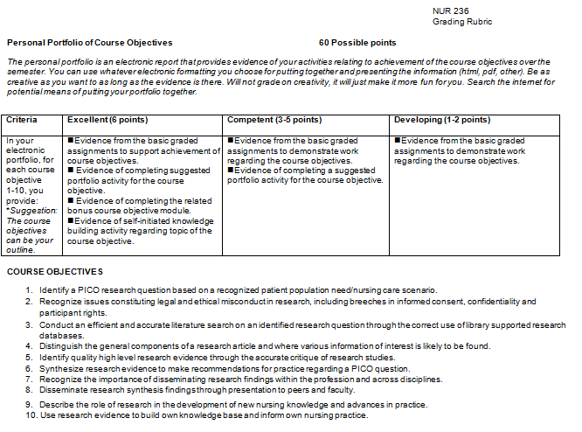

Slide 55
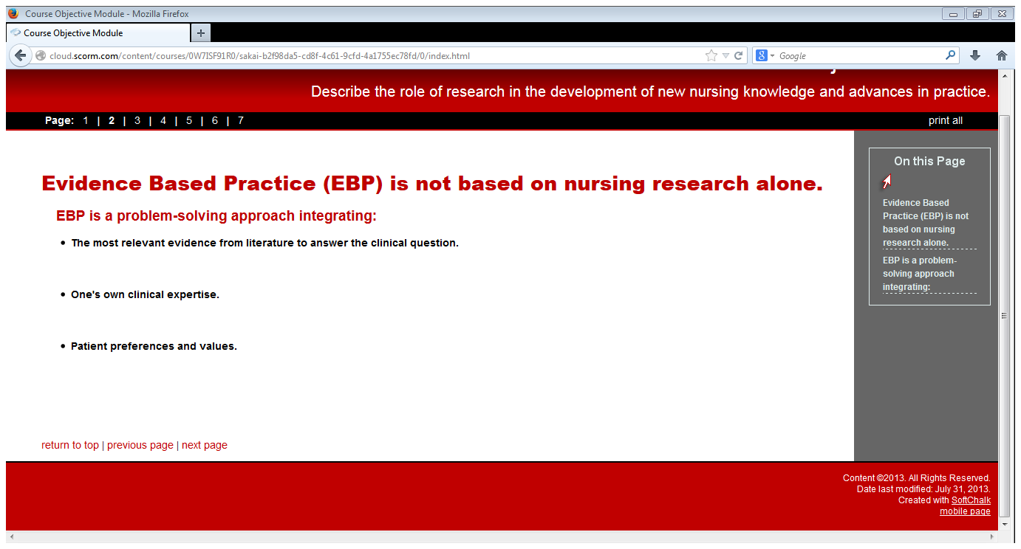

Slide 56
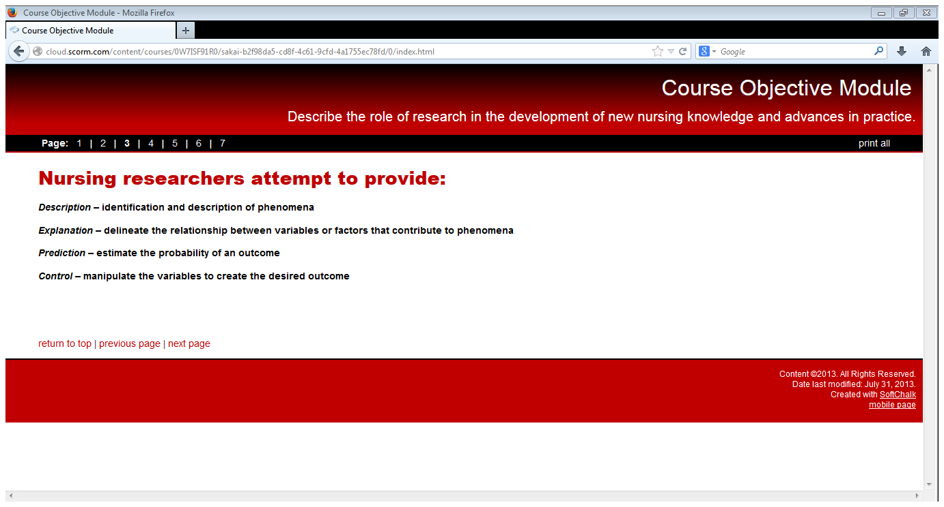

Slide 58
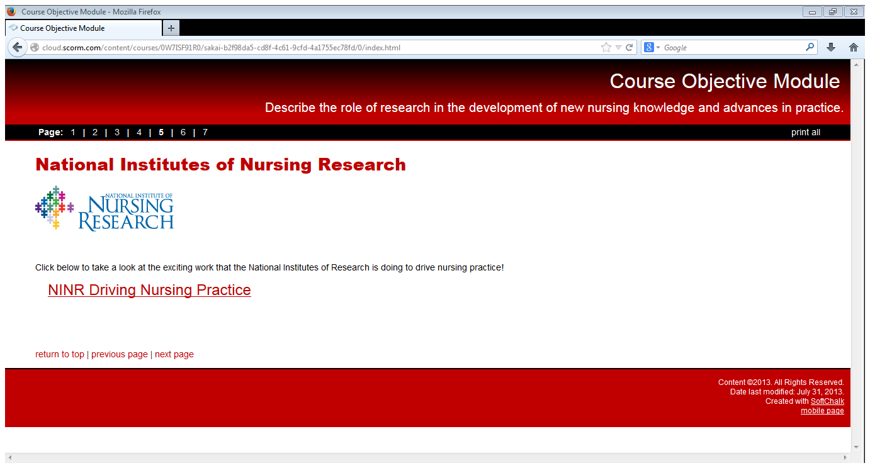

Slide 59
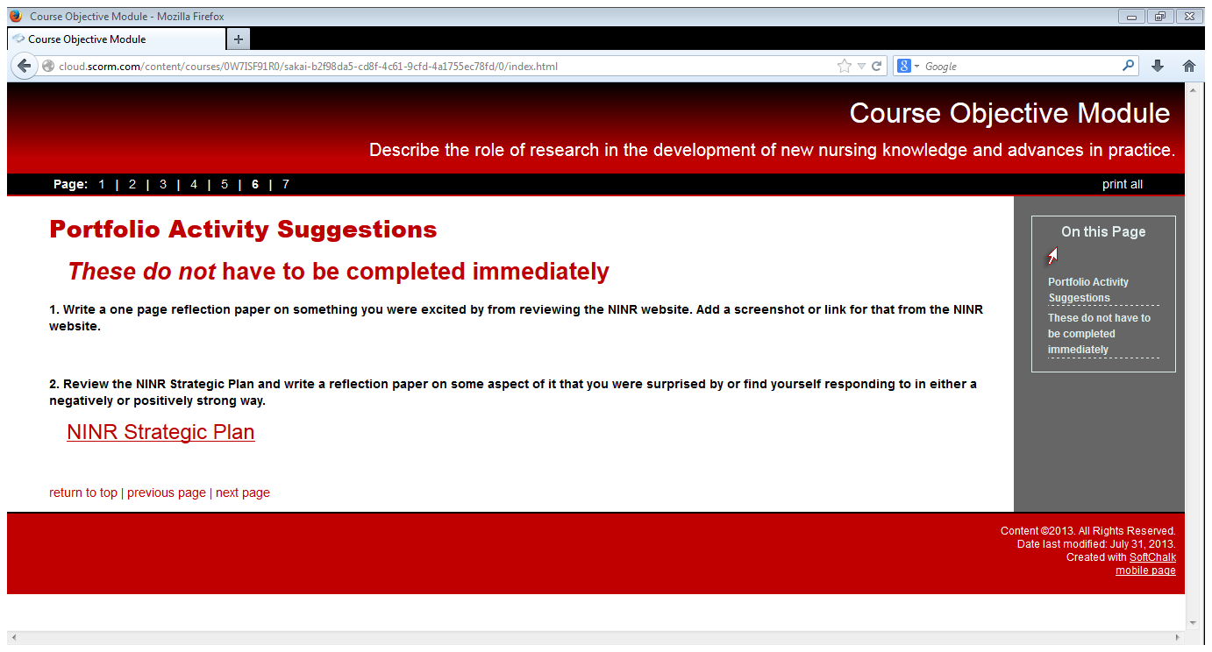

Slide 60
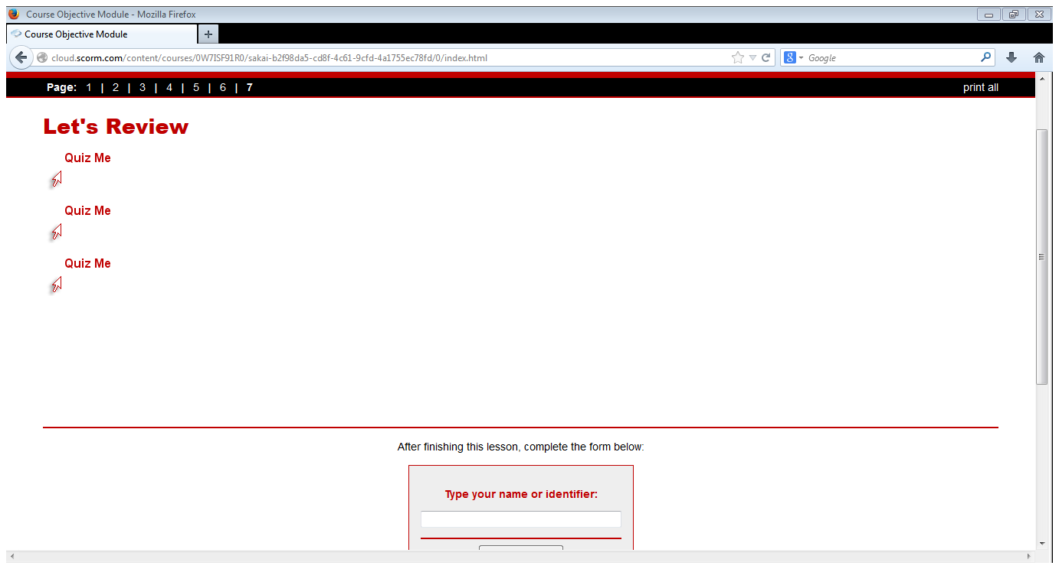

Slide 61
Q & A
Questions
Comments

Slide 62
Thank you all!
Warm wishes for a fantastic semester!
Eric, Rick, Bill, Marcena, and May

